Slide 2
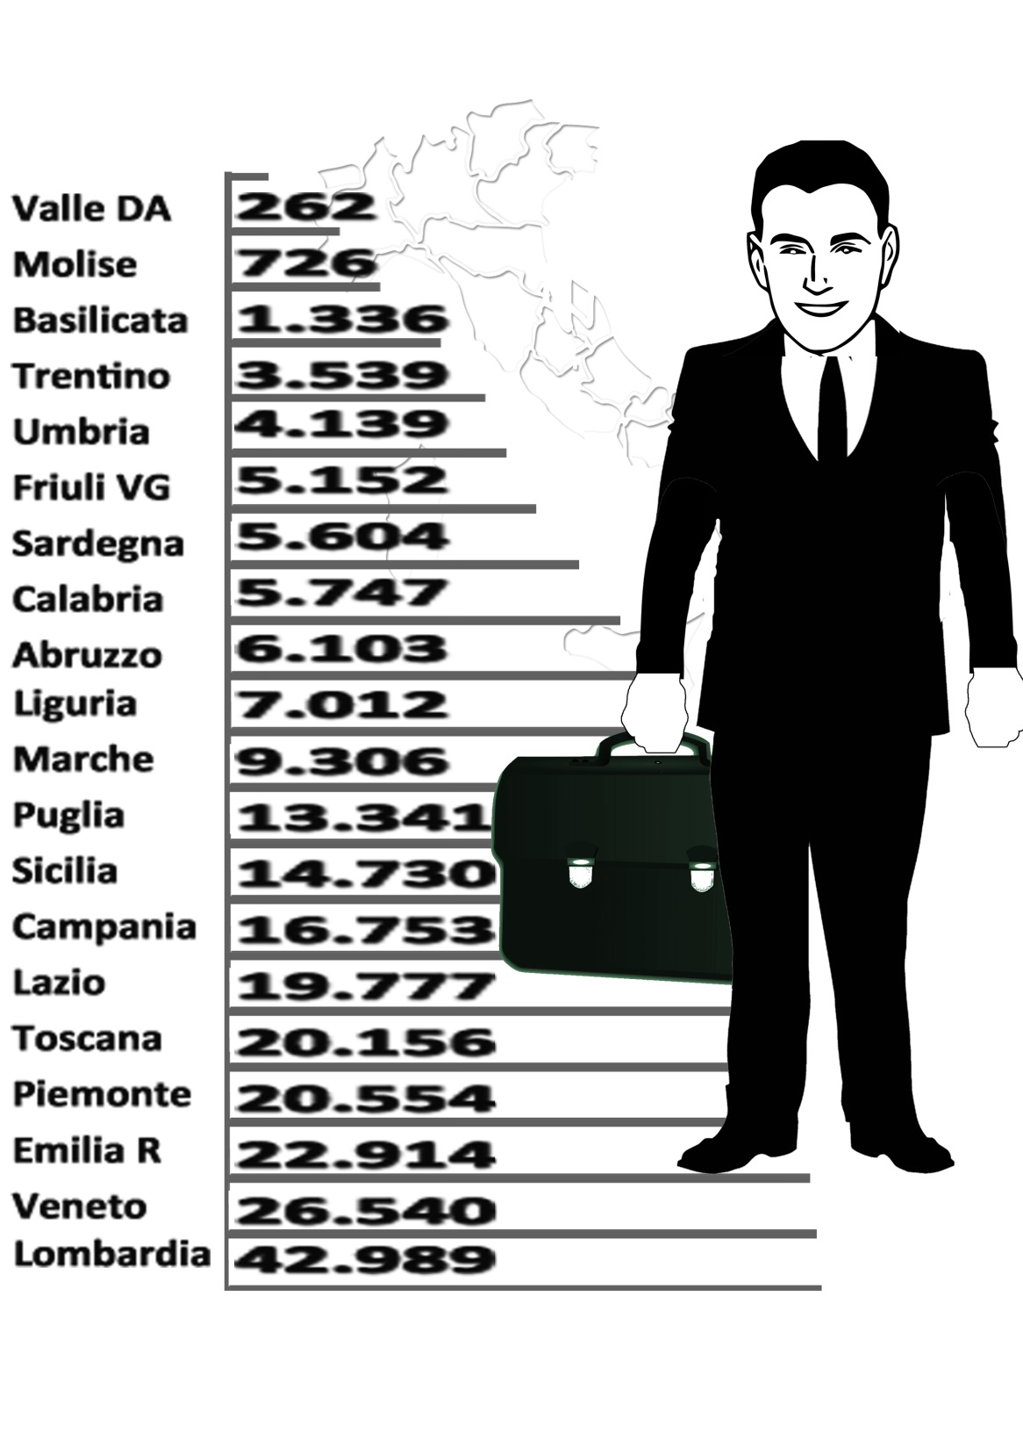
Commercial Agents per Region
Commercial Agents in Italy are 240.000
Notes:
Geolocalization

Slide 3
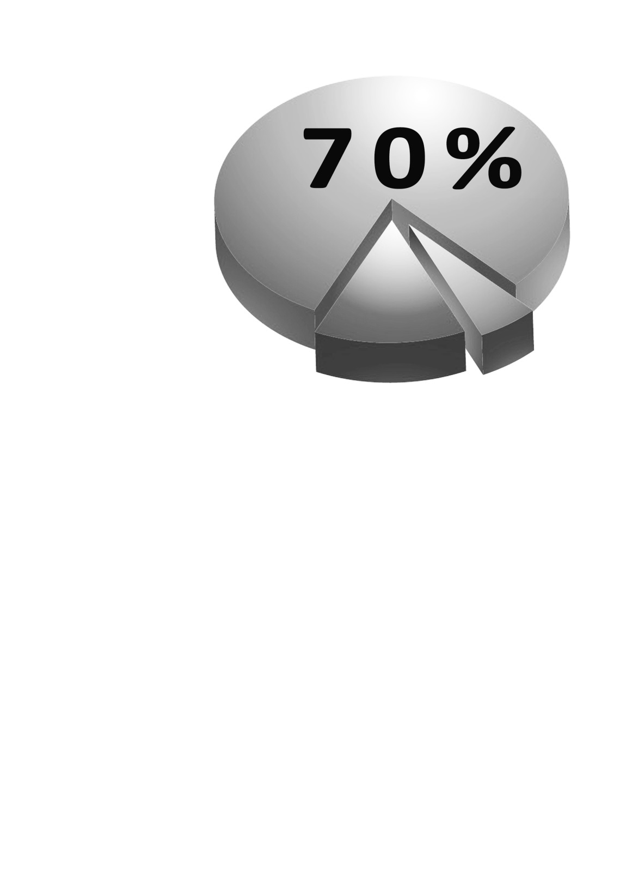
Commercial Agents
generate the
70% GDP

Slide 4
Italian Web Portals
Notes:
Italian Platform

Slide 5
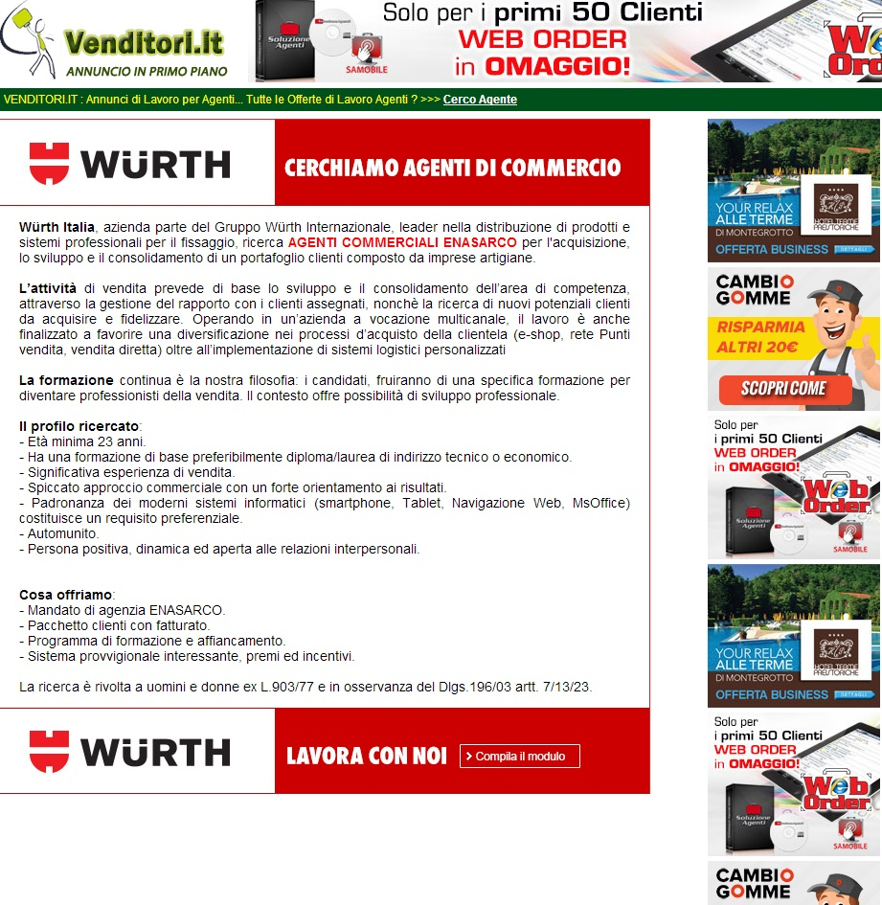
Online AD Research

Slide 6
59.685.227 potential consumers of your products / services IV Country UE (in order of population after Germany, France and the United Kingdom) 23º in the World

Slide 8
Enrico Seminara AGENT321 Vice President Mobile +39.335.133.59.35 Italian Office + 39 06.41.21.71.44 E-Mail: enrico.seminara@agent321.com WEB: www.ForumAgenti.IT
Napoli 14 e 15 Marzo 2014

